Slide 1
CIS 4301: Constraints
Pete Dobbins

Slide 2
Outline
Foreign Keys
Local Constraints
Global Constraints
Triggers

Slide 3
Constraints
A relationship among data elements that the DBMS is required to enforce.
Keys
Foreign key [provide referential-integrity]
Value-based
Tuple-based
Assertions through SQL boolean expressions

Slide 4
Foreign Keys
Requiring a field value in one relation to be drawn from an existing field value in another relation.
Sells ( bar, beer, price )
beer must be a real beer and correspond to a record in Beers.name
Referenced attributes [attribute in the other relation; e.g. Beers.name] must be declared as a PRIMARY KEY or UNIQUE.

Slide 5
Foreign Keys
Within attribute declaration
Keyword: REFERENCES
<attribute> TYPE REFERENCES <relation> ( <attribute> )
– or –
As a schema element
Keywords: FOREIGN KEY and REFERENCES
FOREIGN KEY ( <attribute>, … )
REFERENCES <relation> ( <attribute>, … )

Slide 6
Within Attribute Declaration
CREATE TABLE Beers (
name CHAR(25) PRIMARY KEY,
brewer CHAR(25)
);
CREATE TABLE Sells (
bar CHAR(25),
beer CHAR(25) REFERENCES Beers ( name ),
price REAL,
PRIMARY KEY ( bar, beer )
);

Slide 7
Schema Element
CREATE TABLE Beers (
name CHAR(25) PRIMARY KEY,
brewer CHAR(25)
);
CREATE TABLE Sells (
bar CHAR(25),
beer CHAR(25),
price REAL,
PRIMARY KEY (bar, beer),
FOREIGN KEY (beer) REFERENCES Beers (name)
);

Slide 8
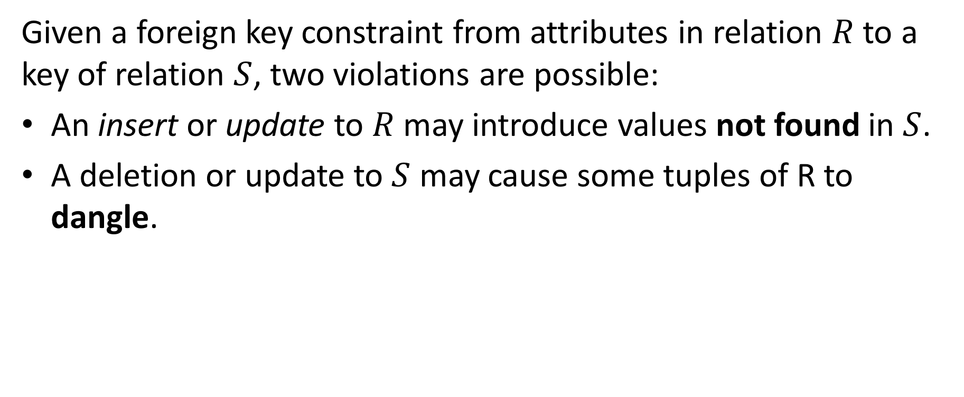
Foreign Key Complications
Given a foreign key constraint from attributes in relation $R$ to a key of relation $S$, two violations are possible:
An insert or update to $R$ may introduce values not found in $S$.
A deletion or update to $S$ may cause some tuples of R to dangle.

Slide 9
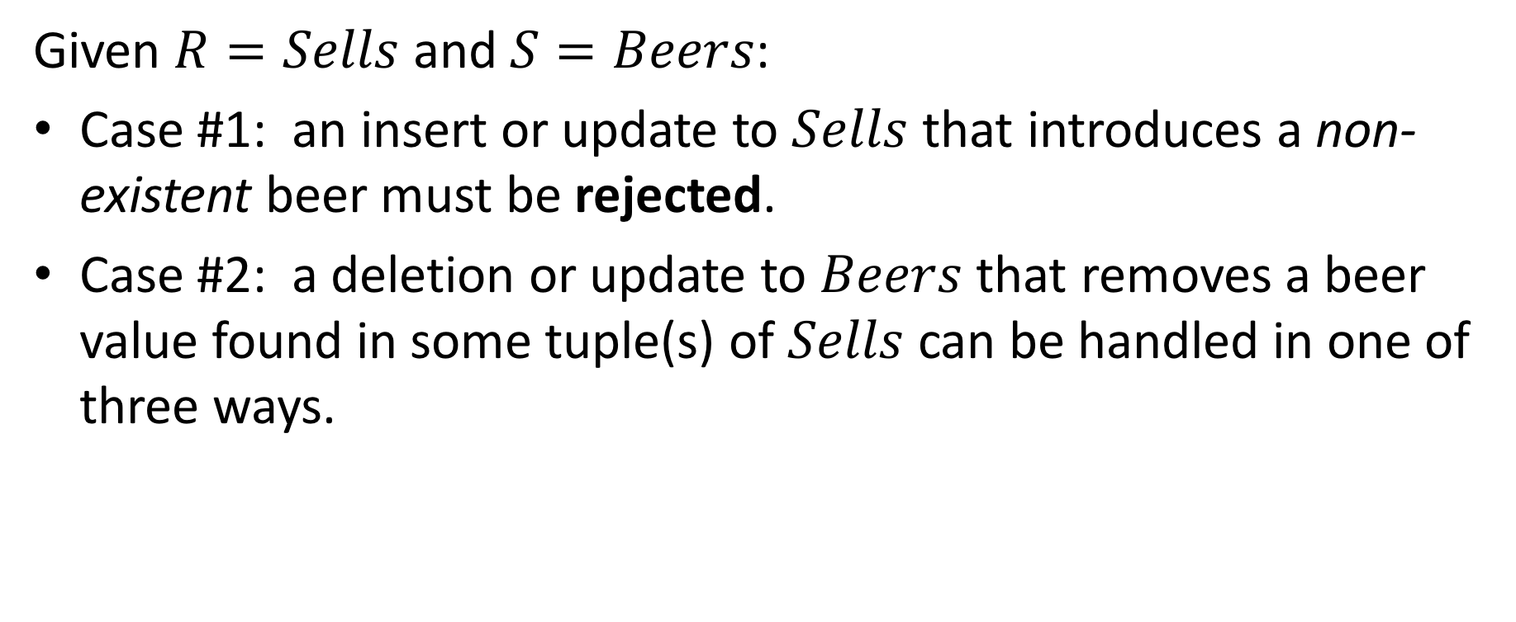
Handling Violations
Given $R=Sells$ and $S=Beers$:
Case #1: an insert or update to $Sells$ that introduces a non-existent beer must be rejected.
Case #2: a deletion or update to $Beers$ that removes a beer value found in some tuple(s) of $Sells$ can be handled in one of three ways.

Slide 10
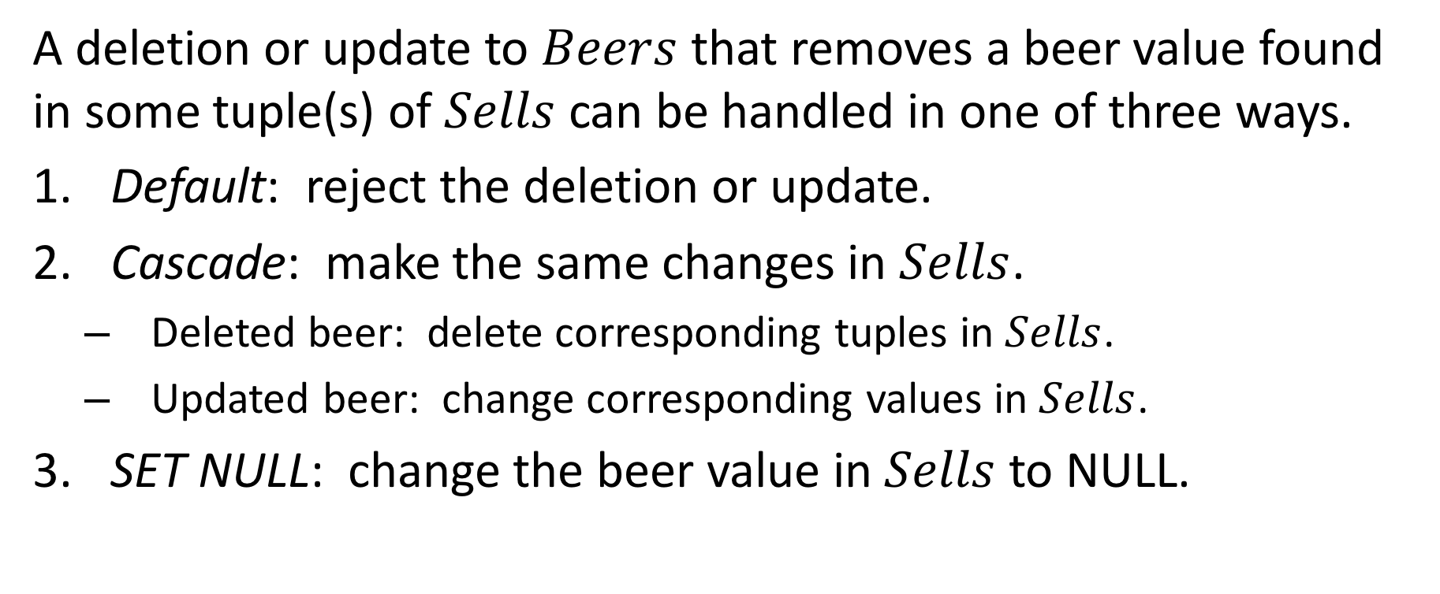
Handling Violations: Case #2
A deletion or update to $Beers$ that removes a beer value found in some tuple(s) of $Sells$ can be handled in one of three ways.
Default: reject the deletion or update.
Cascade: make the same changes in $Sells$.
Deleted beer: delete corresponding tuples in $Sells$.
Updated beer: change corresponding values in $Sells$.
SET NULL: change the beer value in $Sells$ to NULL.

Slide 11
Example: Cascade
In order to perform:
DELETE FROM Beers
WHERE name = 'Bud';
The cascading operation is:
DELETE FROM Sells
WHERE beer = 'Bud';

Slide 12
Example: Cascade
In order to perform:
UPDATE Beers
SET name = 'Budweiser'
WHERE name = 'Bud';
The cascading operation is:
UPDATE Sells
SET beer = 'Budweiser'
WHERE beer = 'Bud';

Slide 13
Example: Set NULL
In order to perform:
DELETE FROM Beers
WHERE name = 'Bud';
The cascading operation is:
UPDATE Sells
SET beer = NULL
WHERE beer = 'Bud';

Slide 14
Example: Set NULL
In order to perform:
UPDATE Beers
SET name = 'Budweiser'
WHERE name = 'Bud';
The cascading operation is:
UPDATE Sells
SET beer = NULL
WHERE beer = 'Bud';

Slide 15
Choosing a Policy
When no policy is specified, the default option [MariaDB keyword: RESTRICT] rejecting any such modification is utilized.
When declaring a foreign key, CASCADE or SET NULL can be set individually for both DELETE and UPDATE operations.

Slide 16
Choosing a Policy
CREATE TABLE Sells (
bar CHAR(25),
beer CHAR(25),
price REAL,
PRIMARY KEY (bar, beer),
FOREIGN KEY (beer) REFERENCES Beers (name)
ON DELETE SET NULL
ON UPDATE CASCADE
);

Slide 17
Practicing…
Practice creating tables with foreign key constraints, using the examples given.
Create delete, insert, and update operations that express the usage of these foreign key constraints.
Note, the previous slide [#16] has an error. What is the error? Why is it occurring? How can the error be resolved?

Slide 18
Attribute-Based CHECKs
Constraints on the value of a particular attribute.
Add: CHECK ( <condition> ) to the declaration of the attribute.
MariaDB does not allow subqueries to be a part of the check, however some DBMSs do include this option.
The condition may use the name of the attribute, however any other relation or attribute name must be packaged within a subquery.

Slide 19
Example: Attribute-Based CHECK
CREATE TABLE Sells (
bar CHAR(25),
beer CHAR(25) CHECK ( beer IN ( SELECT name FROM Beers ) ),
price REAL CHECK ( price <= 5.00 ),
PRIMARY KEY (bar, beer)
);

Slide 20
Example: Attribute-Based CHECK
At this time, not available in MariaDB
CREATE TABLE Sells (
bar CHAR(25),
beer CHAR(25) CHECK ( beer IN ( SELECT name FROM Beers ) ),
price REAL CHECK ( price <= 5.00 ),
PRIMARY KEY (bar, beer)
);
A valid MariaDB Check

Slide 21
Example: Attribute-Based CHECK
CREATE TABLE Sells (
bar CHAR(25),
beer CHAR(25),
price REAL CHECK ( price <= 5.00 ),
PRIMARY KEY (bar, beer),
FOREIGN KEY ( beer ) REFERENCES Beers ( name )
);

Slide 22
CHECK Timing
Attribute-based CHECKs are performed only when a value for that attribute is inserted or updated.
CHECK ( price <= 5.00 ): checks every new price and rejects any INSERTs / UPDATEs that violate this constraint.
CHECK ( beer IN ( SELECT name FROM Beers ) ): is not checked if a beer is deleted from Beers (unlike with a foreign key), thus there is no DELETE / INSERT / UPDATE policy enforcing consistency.

Slide 23
Tuple-Based CHECKs
Constraints on the value of tuples.
Add: CHECK ( <condition> ) as a schema element.
The condition may refer to any attribute of the relation.
The CHECK is performed on only INSERTs / UPDATEs.

Slide 24
Example: Tuple-Based CHECK
CREATE TABLE Sells (
bar CHAR(25),
beer CHAR(25),
price REAL,
PRIMARY KEY (bar, beer),
FOREIGN KEY ( beer ) REFERENCES Beers ( name ),
CHECK ( bar = 'Joes Place' OR price <= 5.00 )
);

Slide 25
ASSERTIONs
ASSERTIONs are part of the SQL standard but are not implemented by many DBMS, including not being an option in MariaDB. They are a database schema element, like relations and views. The <condition> may refer to any relation or attribute in the schema.
CREATE ASSERTION <name>
CHECK ( <condition> );

Slide 26
Example: ASSERTION
CREATE ASSERTION PriceCeiling CHECK (
NOT EXISTS (
SELECT bar FROM Sells
GROUP BY bar
HAVING 5.00 < AVG ( price )
) );

Slide 27
Example: ASSERTION
CREATE ASSERTION FewerBars CHECK (
( SELECT COUNT(*) FROM Bars ) <=
( SELECT COUNT(*) FROM Drinkers )
);

Slide 28
ASSERTION Timing
In principle, every assertion must be checked when performing a modification to any relation in the database.
A clever DBMS implementation will observe that only certain modifications will cause a given assertion to be violated.
No change to Beers can affect FewerBars.
Similarly, no insertions into Drinkers will affect FewerBars.

Slide 29
TRIGGERs
Assertions are powerful, but tricky for the DBMS to efficiently determine when they need to be checked.
Attribute and Tuple-based checks are checked at known times, but are not very powerful.
TRIGGERs allow the DBA a solution to structuring when to check for a powerful condition.

Slide 30
TRIGGERs
TRIGGERs or Event-Condition-Action (ECA) rules:
Event: typically a type of database modification, e.g. “INSERT ON Sells.”
Condition: Any SQL boolean-valued expression.
Action: Any SQL statements used in response to the condition.

Slide 31
Example: SellsInsertTrigger
Instead of using a foreign key constraint and rejecting insertions into Sells( bar, beer, price ) when the beer is unknown by Beers( name, brewer ), a TRIGGER can add the beer into Beers with a NULL manufacturer.

Slide 32
Example: SellsInsertTrigger
CREATE TRIGGER SellsInsertTrigger
AFTER INSERT ON Sells
FOR EACH ROW
BEGIN
IF NEW.beer NOT IN
(SELECT name FROM Beers) THEN
INSERT INTO Beers(name)
VALUES( NEW.beer ) ;
END IF ;
END ;

Slide 33
Example: SellsInsertTrigger
CREATE TRIGGER SellsInsertTrigger
AFTER INSERT ON Sells
FOR EACH ROW
BEGIN
IF NEW.beer NOT IN
(SELECT name FROM Beers) THEN
INSERT INTO Beers(name)
VALUES( NEW.beer ) ;
END IF ;
END ;
The Event

Slide 34
Example: SellsInsertTrigger
CREATE TRIGGER SellsInsertTrigger
AFTER INSERT ON Sells
FOR EACH ROW
BEGIN
IF NEW.beer NOT IN
(SELECT name FROM Beers) THEN
INSERT INTO Beers(name)
VALUES( NEW.beer ) ;
END IF ;
END ;
The
Condition

Slide 35
Example: SellsInsertTrigger
CREATE TRIGGER SellsInsertTrigger
AFTER INSERT ON Sells
FOR EACH ROW
BEGIN
IF NEW.beer NOT IN
(SELECT name FROM Beers) THEN
INSERT INTO Beers(name)
VALUES( NEW.beer ) ;
END IF ;
END ;
The Action

Slide 36
Example: SellsInsertTrigger
CREATE TRIGGER SellsInsertTrigger
AFTER INSERT ON Sells
FOR EACH ROW
BEGIN
IF NEW.beer NOT IN
(SELECT name FROM Beers) THEN
INSERT INTO Beers(name)
VALUES( NEW.beer ) ;
END IF ;
END ;
The Event
The
Condition
The Action

Slide 37
But This Generates an Error!
MariaDB [test]> CREATE TRIGGER SellsInsertTrigger
AFTER INSERT ON Sells
FOR EACH ROW
BEGIN
IF NEW.beer NOT IN
(SELECT name FROM Beers) THEN
INSERT INTO Beers(name)
VALUES( NEW.beer ) ;
ERROR 1064 (42000): You have an error in your SQL syntax; check the manual that corresponds to your MariaDB server version for the right syntax to use near '' at line 8

Slide 38
But This Generates an Error!
MariaDB [test]> END IF ;
ERROR 1064 (42000): You have an error in your SQL syntax; check the manual that corresponds to your MariaDB server version for the right syntax to use near 'END IF' at line 1

Slide 39
The Problem
CREATE TRIGGER SellsInsertTrigger
AFTER INSERT ON Sells
FOR EACH ROW
BEGIN
IF NEW.beer NOT IN
(SELECT name FROM Beers) THEN
INSERT INTO Beers(name)
VALUES( NEW.beer ) ;
END IF ;
END ;
Conflicting end points
for the TRIGGER

Slide 40
A Note on Syntax
TRIGGERs provide the opportunity to include statements to execute under certain conditions. These statements could include complete SQL operations like those we have been discussing [for example a complete INSERT statement] or programmatic statements that are written in a more traditional fashion. These same implementation options are available when creating Stored Procedures [functions].

Slide 41
So What’s the Problem?
Sub-statements are included within a BEGIN … END block and need to be closed using the standard semi-colon ; … creating a conflict in the usage of the ; delimiter.
How do we identify if a given ; ends the creation of the TRIGGER or is merely completing a sub-statement within BEGIN … END block contained within the TRIGGER?

Slide 42
Solution: Setting the DELIMITER
DELIMITER |
CREATE TRIGGER SellsInsertTrigger
AFTER INSERT ON Sells
FOR EACH ROW
BEGIN
IF NEW.beer NOT IN
(SELECT name FROM Beers) THEN
INSERT INTO Beers(name)
VALUES( NEW.beer ) ;
END IF ;
END |
SELECT * FROM Beers |

Slide 43
Solution: Setting the DELIMITER
Set a new DELIMITER for SQL outside of the BEGIN … END BLOCK
DELIMITER |
CREATE TRIGGER SellsInsertTrigger
AFTER INSERT ON Sells
FOR EACH ROW
BEGIN
IF NEW.beer NOT IN
(SELECT name FROM Beers) THEN
INSERT INTO Beers(name)
VALUES( NEW.beer ) ;
END IF ;
END |

Slide 44
Solution: Setting the DELIMITER
DELIMITER |
CREATE TRIGGER SellsInsertTrigger
AFTER INSERT ON Sells
FOR EACH ROW
BEGIN
IF NEW.beer NOT IN
(SELECT name FROM Beers) THEN
INSERT INTO Beers(name)
VALUES( NEW.beer ) ;
END IF ;
END |
Within BEGIN … END block, the ; remains the statement delimiter

Slide 45
Solution: Setting the DELIMITER
DELIMITER |
CREATE TRIGGER SellsInsertTrigger
AFTER INSERT ON Sells
FOR EACH ROW
BEGIN
IF NEW.beer NOT IN
(SELECT name FROM Beers) THEN
INSERT INTO Beers(name)
VALUES( NEW.beer ) ;
END IF ;
END |
Iterate over every inserted tuple

Slide 46
Example: PriceHikes
CREATE TABLE PriceHikes (
bar VARCHAR(25),
beer VARCHAR(25),
price_before REAL,
price_after REAL,
PRIMARY KEY ( bar, beer )
);

Slide 47
Example: PriceHikesTrigger1
DELIMITER |
CREATE TRIGGER PriceHikesTrigger1
BEFORE UPDATE ON Sells
FOR EACH ROW
BEGIN
IF NEW.price > OLD.price + 1 THEN
INSERT INTO PriceHikes( bar, beer, price_before, price_after )
VALUES( NEW.bar, NEW.beer, OLD.price, NEW.price ) ;
END IF ;
END |
DELIMITER ;

Slide 48
Example: PriceHikesTrigger1
DELIMITER |
CREATE TRIGGER PriceHikesTrigger1
BEFORE UPDATE ON Sells
FOR EACH ROW
BEGIN
IF NEW.price > OLD.price + 1 THEN
INSERT INTO PriceHikes( bar, beer, price_before, price_after )
VALUES( NEW.bar, NEW.beer, OLD.price, NEW.price ) ;
END IF ;
END |
DELIMITER ;
Keyword OLD: references the data in the corresponding field/tuple before the UPDATE

Slide 49
Example: PriceHikesTrigger1
DELIMITER |
CREATE TRIGGER PriceHikesTrigger1
BEFORE UPDATE ON Sells
FOR EACH ROW
BEGIN
IF NEW.price > OLD.price + 1 THEN
INSERT INTO PriceHikes( bar, beer, price_before, price_after )
VALUES( NEW.bar, NEW.beer, OLD.price, NEW.price ) ;
END IF ;
END |
DELIMITER ;
Keyword NEW: references the data in the corresponding field/tuple after the UPDATE

Slide 50
Example: PriceHikesTrigger2 Complete
DELIMITER |
CREATE TRIGGER PriceHikesTrigger2
BEFORE UPDATE ON Sells
FOR EACH ROW
BEGIN
DECLARE old_price REAL;
SET old_price =
( SELECT price
FROM Sells
WHERE Sells.bar = NEW.bar AND Sells.beer = NEW.beer );
IF NEW.price > old_price + 1 THEN
INSERT INTO PriceHikes( bar, beer, price_before, price_after )
VALUES( NEW.bar, NEW.beer, old_price, NEW.price );
END IF ;
END |
DELIMITER ;

Slide 51
Example: PriceHikesTrigger2 Complete
DELIMITER |
CREATE TRIGGER PriceHike
BEFORE UPDATE ON Sells
FOR EACH ROW
BEGIN
DECLARE old_price REAL;
SET old_price =
( SELECT price
FROM Sells
WHERE Sells.bar = NEW.bar AND Sells.beer = NEW.beer );
IF NEW.price > old_price + 1 THEN
INSERT INTO PriceHikes( bar, beer, price_before, price_after )
VALUES( NEW.bar, NEW.beer, old_price, NEW.price );
END IF ;
END |
DELIMITER ;
Declaring , initializing, and using a local variable

Slide 52
Example: PriceHikesTrigger2…
DELIMITER |
CREATE TRIGGER PriceHikesTrigger2
BEFORE UPDATE ON Sells
FOR EACH ROW
BEGIN
DECLARE old_price REAL;
# continued...

Slide 53
Example: PriceHikesTrigger2…
DELIMITER |
CREATE TRIGGER PriceHikesTrigger2
BEFORE UPDATE ON Sells
FOR EACH ROW
BEGIN
DECLARE old_price REAL;
# continued...
Declaring a
local variable

Slide 54
Example: …PriceHikesTrigger2…
# …continued from DECLARE old_price REAL;
SET old_price =
( SELECT price
FROM Sells
WHERE Sells.bar = NEW.bar AND Sells.beer = NEW.beer );
# continued...

Slide 55
Example: …PriceHikesTrigger2…
# …continued from DECLARE old_price REAL;
SET old_price =
( SELECT price
FROM Sells
WHERE Sells.bar = NEW.bar AND Sells.beer = NEW.beer );
# continued...
Initializing a
local variable

Slide 56
Example: …PriceHikesTrigger2
# … continued
IF NEW.price > old_price + 1 THEN
INSERT INTO PriceHikes( bar, beer, price_before, price_after )
VALUES( NEW.bar, NEW.beer, old_price, NEW.price );
END IF ;
END |
DELIMITER ;

Slide 57
Example: …PriceHikesTrigger2
Using a
local variable
# … continued
IF NEW.price > old_price + 1 THEN
INSERT INTO PriceHikes( bar, beer, price_before, price_after )
VALUES( NEW.bar, NEW.beer, old_price, NEW.price );
END IF ;
END |
DELIMITER ;

Slide 58
User-Defined Variables
Session specific
Not shared between users [even if both are connected to the same DB]
Declaration not required, any reference defaults to null
Can be just initialized and used

Slide 59
User-Defined Variables: Assignment
At prompt and within procedures:
SET @<variable> = <value>;
SELECT @<attribute> INTO <variable>;
Within procedures:
@<variable> := <value>;

Slide 60
User-Defined Variables: Examples
SET @total = 0;
SELECT @total;
SELECT *, (@total := @total + 1) as Total FROM Sells;
SELECT @total;

Slide 61
User-Defined Variables: Examples
SELECT *, (@total := @total + 1) as Total FROM Sells;
# try this with only the =, [ without the colon ], in the :=
SELECT *, (@total = @total + 1) as Total FROM Sells;
# try this with only the = and without +1
SELECT *, (@total = @total) as Total FROM Sells;

Slide 62
User-Defined Variables: Examples
SELECT bar, beer
INTO @x, @y
FROM Sells;
ERROR 1172 (42000): Result consisted of more than one row

Slide 63
User-Defined Variables: Examples
SELECT beer, price
INTO @beer, @price
FROM Sells
WHERE bar='Joes Place' AND beer='bud';
SELECT @beer, @price;

Slide 64
User-Defined Variables: Examples
SELECT beer, price
INTO @beer, @price
FROM Sells
WHERE bar='Joes Place' AND beer='Modela’;
SELECT @beer, @price;

Slide 65
Example: SellsChangeTrigger
SET @change = 0;
SET @total = 0;
DELIMITER |
CREATE TRIGGER SellsChangeTrigger
BEFORE UPDATE ON Sells
FOR EACH ROW
BEGIN
SET @change = NEW.price - OLD.price;
SET @total = @total + @change;
END |
DELIMITER ;

Slide 66
Evaluate: SellsChangeTrigger
UPDATE Sells
SET price = 5.00
WHERE bar = 'Joes Place' AND beer = 'busch';
UPDATE Sells
SET price = 12.00
WHERE bar = 'Happy Hour' AND beer = 'busch';
UPDATE Sells
SET price = 7.00
WHERE bar = 'Happy Hour' AND beer = 'MGD';
SELECT @change;
SELECT @total;

Slide 67
VIEWs: Synergy1
CREATE VIEW Synergy1 AS
SELECT Likes.drinker, Likes.beer, Sells.bar
FROM Frequents, Likes, Sells
WHERE Frequents.drinker = Likes.drinker AND
Likes.beer = Sells.beer AND
Frequents.bar = Sells.bar
;
SELECT * FROM Synergy1;

Slide 68
VIEWS: Synergy2
CREATE VIEW Synergy2 AS
SELECT drinker, bar, beer
FROM ( Frequents AS F2 NATURAL JOIN
( Likes NATURAL JOIN
( Frequents AS F1 NATURAL JOIN Sells )
)
)
;
SELECT * FROM Synergy2;

Slide 69
Modifying Tables through VIEWs?
INSERT INTO Synergy1 ( drinker, beer, bar )
VALUES ( 'Bob', 'Shock Top', 'Joes Place' );
In MariaDB: cannot modify more than one base table.

Slide 70
MariaDB: INSTEAD OF
DELIMITER |
CREATE TRIGGER InsertSynergy1
INSTEAD OF INSERT ON Synergy1
FOR EACH ROW
BEGIN
INSERT INTO LIKES( drinker, beer ) VALUES ( NEW.drinker, NEW.beer );
INSERT INTO SELLS( bar, beer ) VALUES ( NEW.bar, NEW.beer );
INSERT INTO FREQUENTS( drinker, bar ) VALUES ( NEW.drinker, NEW.bar );
END |
DELIMITER ;
INSTEAD OF
is NOT valid in MariaDB [although it is in other DBMS]

Slide 71
MariaDB: TRIGGERs on Base Tables, Not Views
DELIMITER |
CREATE TRIGGER InsertSynergy1
BEFORE INSERT ON Synergy1
FOR EACH ROW
BEGIN
INSERT INTO LIKES( drinker, beer ) VALUES ( NEW.drinker, NEW.beer );
INSERT INTO SELLS( bar, beer ) VALUES ( NEW.bar, NEW.beer );
INSERT INTO FREQUENTS( drinker, bar ) VALUES ( NEW.drinker, NEW.bar );
END |
DELIMITER ;
BEFORE
is valid

Slide 72
MariaDB: TRIGGERs on Base Tables, Not Views
DELIMITER |
CREATE TRIGGER InsertSynergy1
BEFORE INSERT ON Synergy1
FOR EACH ROW
BEGIN
INSERT INTO LIKES( drinker, beer ) VALUES ( NEW.drinker, NEW.beer );
INSERT INTO SELLS( bar, beer ) VALUES ( NEW.bar, NEW.beer );
INSERT INTO FREQUENTS( drinker, bar ) VALUES ( NEW.drinker, NEW.bar );
END |
DELIMITER ;
Modifying a view (non-base table) via a trigger is NOT valid

Slide 73
MariaDB: A Valid Sequence
As a practice exercise:
Create a VIEW that references one Base Table.
Now, modifications can be performed through the VIEW.
Create a TRIGGER that responds to a DELETE / INSERT / UPDATE either BEFORE or AFTER the specific modification of the Base Table is performed.
Then, since the VIEW modifies the Base Table, the TRIGGER will respond when modifications are made directly to the Base Table or indirectly through the VIEW.

Slide 74
Exercise
Create a trigger that will respond to an UPDATE to the Sells table, preventing the average beer price of a bar from exceeding $3.

